Slide 1
Ever After and The Ash Girl: New Versions of Cinderella at the Turn of the Century
English Department, National Chengchi University
Taipei, Taiwan (R.O.C.)
Ph. D Candidate
Yi-chin Shih
94551502@nccu.edu.tw

Slide 2
A. Introduction
The first part of the paper analyzes Ever After, focusing on the new image of the cinder girl Danielle, DaVinci as a fairy godmother, and the usage of storytelling.
Then the second part discusses The Ash Girl, examining how Wertenbaker reshapes Ashgirl through bringing in contemporary issues of race, psychological motivation to the absent father and seven deadly sins.
The comparison between the two works would be the third part of the paper. It argues that no matter what performance form of Cinderella story is, the element of fairy-tale romance, which is easily criticized by feminists for its patriarchal ideology, still maintains. The paper suggests that Ever After and The Ash Girl not only are two new versions of Cinderella, but they also represent that fairy tales and romance could be full of feminist awakening, not simply the patriarchal complice.

Slide 3
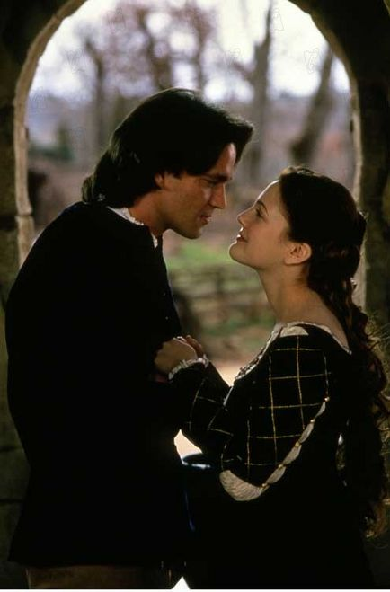
B. Ever After: A Cinderella Story (1998)
1. Danielle: A Reshape of Cinder Girl
a. The Cinderella in Ever After is Danielle de Barbarac and the prince is Henry II of France. By giving Cinderella and the prince identities, the heroine finally has a name, not a nickname, Cinderella, and the identity of the hero infers that the background sets in France in the 16th century.
b. Old Cinderella: unbelievably passive, charming appearance, small feet, an idealized femininity.
Henry and Danielle http://www.screenrush.co.uk/personne/galerievignette_gen_cpersonne=6049&cmediafichier=18830076.html (Retrieved February 22, 2009)

Slide 4
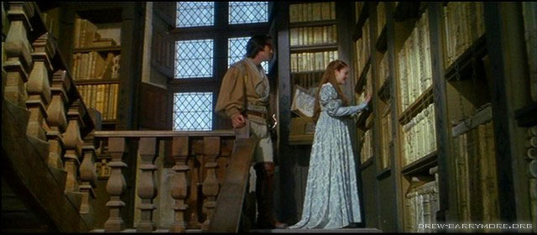
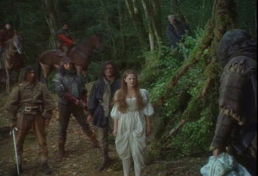

B. Ever After: A Cinderella Story (1998)
c. Cinderella in Ever After: Danielle’s physical strength and her interest in books are valued.
(1) Danielle loves reading. http://www.everaftercostumes.com/blue.shtml (Retrieved February 22, 2009)
(2) Danielle fights with gypsies. http://www.everaftercostumes.com/blue.shtml (Retrieved February 22, 2009)
(3) Danielle is an expert fencer. fencerhttp://www.hotflick.net/celebs/richard_o_brien.html (Retrieved February 22, 2009)
.

Slide 5
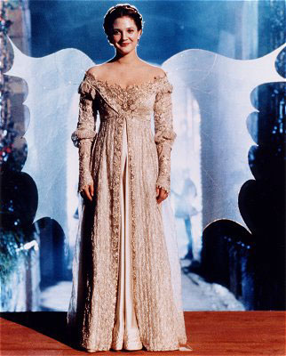
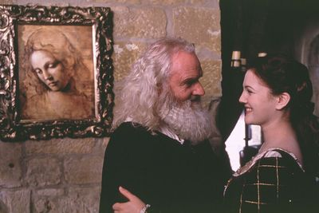
B. Ever After: A Cinderella Story (1998)
d. Danielle’s identity
e. Leonard DaVinci is the fairy godmother in Ever After.
(1) A representative of European Renaissance
(2) A pair of fairy wings
DaVinci’s Man-Made Magic http://www.everaftercostumes.com/breathe.shtml (Retrieved February 22, 2009)
Leonard DaVinci and Danielle
http://gallery.photowant.com/b/gallery.cfm?action=STILL&filmid=fEatm0889003 (Retrieved February 22, 2009)

Slide 6
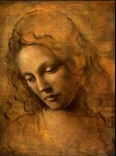
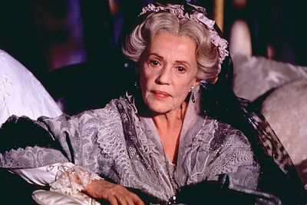
B. Ever After: A Cinderella Story (1998)
2. Ever After: The Strategy of Storytelling
a. Fairy Tales and Romance
b. A female community is formed by storytelling.
The storyteller
http://gallery.photowant.com/b/gallery.cfm?action=STILL&filmid=fEatm0889003 (Retrieved February 22, 2009)
Danielle’s portrait by DaVinci
http://www.everaftercostumes.com/portrait.shtml (Retrieved February 22, 2009)

Slide 7
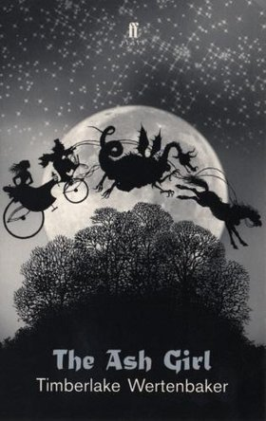
C. The Ash Girl by Wertenbaker
1. Sophia, or Ashgirl: A Reshape of Cinder Girl
a. The Ash Girl stresses another new Cinderella’s transformation from passivity to activity and how she finds her own identity before she could live happily.
b. Ashgirl’s “rite of passage”: separation, liminality and aggregation
The Cover of the Book
http://www.faber.co.uk/work/ash-girl/9780571209422/ (Retrieved February 22, 2009)

Slide 8
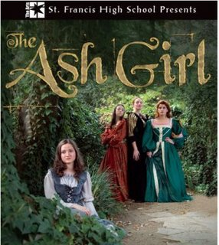
C. The Ash Girl by Wertenbaker
c. Separation: What makes Ashgirl start to separate from her passive status is the news from the palace, saying Prince Amir is going to have a ball.
d. Liminality: it is represented by a forest.
e. Aggregation: By the statement of “I’m not afraid of the shadows of this forest, nor of myself, nor of the future,” Ashgirl successfully moves to the next stage from liminality to aggregation. Princess Zehra’s three questions.
The Ash Girl was presented by St. Francis High School
in 2007. http://marcvaldez.blogspot.com/2007_10_07_marcvaldez_archive.html (Retrieved February 22, 2009)

Slide 9
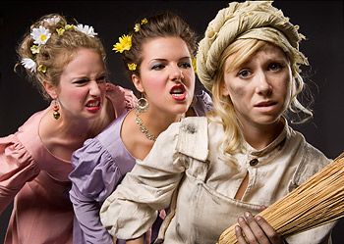
C. The Ash Girl by Wertenbaker
2. The Ash Girl: The Strategy of Filling the Void
a. The absence of the father: the fear of incest
b. Mother’s grotesque body
b. Two stepsisters’ punishment
Stepsisters and Ashgirl. Presented by Studio 58, 2008. http://www2.canada.com/vancouvercourier/news/artsandentertainment/story.html?id=36b3de07-1898-46c2-b824-edecfe6393d0 (Retrieved February 22, 2009)

Slide 10
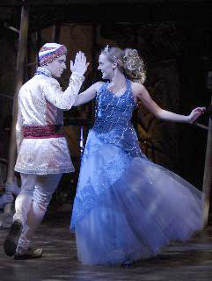
C. The Ash Girl by Wertenbaker
d. Indian Prince: a stranger. The issues of exile, nomad and resettlement.
e. Princess Zehra: a woman as a gift
Prince Amir and Ashgirl. Presented by Performing Arts (College Park, MD) in 2008. http://www.scene4.com/karrenlalondealenier/2008/03/the_ash_girl_and_her_inner_and.html (Retrieved February 22, 2009)

Slide 11
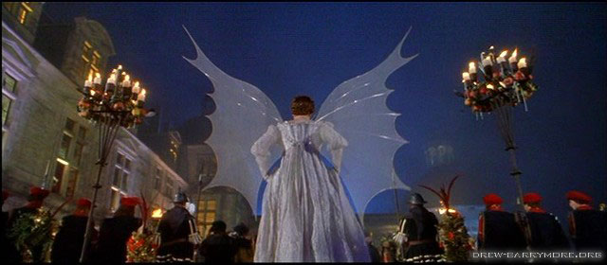
D. Cinderella at the Turn of the Century
1. No matter how these two versions adapt Cinderella story, they both maintain the element of a fairy-tale romance.
2. Reading romance is important for its ability of forming a female community. While Ever After suggests storytelling as a way to form a female community, The Ash Girl forms one by showing a normal girl who is just like us to recall the female audience’s similar experience.
Danielle’s fairy wings http://www.everaftercostumes.com/breathe.shtml (Retrieved February 22, 2009)

Slide 12
D. Cinderella at the Turn of the Century
3. Even though romance may suggest the audience’s resistance to reality and the patriarchal society, these two versions of Cinderella still maintain several patriarchal values.
4. Gramsci’s hegemony: Gramsci’s hegemony is characterized by a combination of force and consent, and it has to negotiate with the subordinate groups in order to maintain its authority.
5. From the perspective of Gramsci’s hegemony, Ever After and The Ash Girl themselves become a field, a site, a process of negotiation of various discourses. The audience senses both patriarchal and feminist discourses in it. Any patriarchal value is questionable and so is any feminist value.

Slide 13

D. Cinderella at the Turn of the Century
6. Romance is not simply a patriarchal complice and not a completely feminist awakening, but it is “a compromise equilibrium” in Gramsci’s term. In this process of negotiation, many different discourses attempt to articulate for themselves and in order to do so, they have to keep negotiating.
Presented by University of Maryland, Department of Theatre, 2008. http://www.theatre.umd.edu/Season/springproductions.htm (Retrieved February 22, 2009)

Slide 14
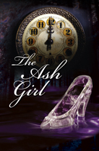
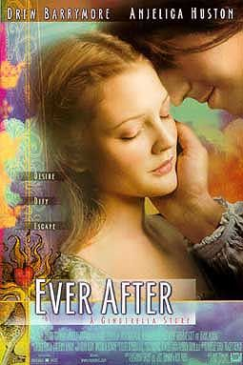
Ever After and The Ash Girl: New Versions of Cinderella at the Turn of the Century
~The End~
Thank you
Presented by Performing Arts Theatre, 2008. http://www.capilanou.ca/news-events/performing-arts/season-performances/theatre.html (Retrieved February 22, 2009)
Ever After Poster http://www.impawards.com/1998/ever_after.html (Retrieved February 22, 2009)

